Slide 1
Software Quality Assurance and Testing
Lecture -05
Harish Aggarwal

Slide 2
Software Testing Fundamentals
Verification and Validation

Slide 3
Re-Cap
Lecture - 01
Definitions – S/W Quality, S/W Quality Assurance
Importance of QA
Causes of Defects
Business Models in S/W
S/W Cost, Quality Cost
Quality culture
Lecture - 02
Software Quality Models
McCall, IEEE 1061, ISO 25000 Series
Quality Requirements
Quality of Requirements
Frameworks
ISO/IEC/IEEE 12207 - Software Life Cycle Processes
Lecture - 03
Frameworks
CMMI-Development
ITIL Framework
Other Frameworks
Lecture - 04
ISO 25010 – Quality Attributes
Functional Suitability, Performance Efficiency, Compatibility, Usability, Reliability, Security, Maintainability, Portability

Slide 4
Agenda
Software Testing Fundamentals
Software Verification and Validation
Types of Testing
Black Box Testing
White Box Testing
Test Levels and Types
Unit Testing
Integration Testing
System Testing

Slide 5
Software Testing Fundamentals
Definition –
Testing is the process of executing a program with intention of finding errors [Myers]
Testing is the process of exercising or evaluating a system or system component by manual or automated means to verify that it satisfies specified requirements. [IEEE 83a]
[IEEE Std 610.12 (IEEE, 1990)] -
The process of operating a system or component under specified conditions, observing or recording the results, and making an evaluation of some aspect of the system or component.
The process of analyzing a software item to detect the differences between existing and required conditions (that is, bugs) and to evaluate the features of the software item

Slide 6
Software Testing Fundamentals
Software testing is a formal process carried out by a specialized testing team in which a software unit, several integrated software units or an entire software package are examined by running the programs on a computer. All the associated tests are performed according to approved test procedures on approved test cases.

Slide 7
Software Testing - Why
The Technical Case:
Competent developers are not infallible.
The implications of requirements are not always foreseeable.
The behavior of a system is not necessarily predictable from its components.
Languages, databases, user interfaces, and operating systems have bugs that can cause application failures.
Reusable classes and objects may have underlying issues.
The Business Case:
If you don’t find bugs your customers or users will.
Post-release debugging is the most expensive form of development.
Buggy software hurts operations, sales, and reputation.
Buggy software can be hazardous to life and property.
Cost of fixing is higher if bugs are found later in the cycle.

Slide 8
Software Testing - Who
Who should be doing the Testing
Development Team.
Product Management Team
Project Management Team
Dedicated Test Team.
Leadership (Alpha Testing, Beta Testing)
Customers
Effectively – It is Team Effort and ongoing process throughout lifecycle of Product Development

Slide 9
Software Testing –
How much
How much Testing should be done.
Studies show that software testing constitutes
About 40% of overall effort and
25% of the overall software budget
Testing is never 100% exhaustive.
Bug Free product is Myth
Reach Acceptable Quality
There is no standard way to measure testing process.
Metrics can be computed at the organizational, process, project, and product levels.
Each set of measurements has its value in monitoring, planning, and control.
Testing is a trade-off between budget, time, and quality.

Slide 10
Software Testing –
Error, Defect, Failure
Error – It is a human mistake which can be caused in any phase of SDLC (Requirements, Design, Coding, Testing)
Defect – Once the error is caused, its representation or manifestation is called as Defect. Defect is also called as Fault or Bug. A Defect is a variance between expected and actual Result
Failure – Execution of Bug is called failure.
→ → → →
Error
Defect
Failure

Slide 11
Software Testing –
Error, Defect, Failure
Error – Its main causes are :
Negligence: Carelessness often leads to errors
Miscommunication: An unclear feature specification or its improper interpretation.
Inexperience: Inexperienced developers often miss out on essential details.
Complexity: Intricate algorithms can cause mistakes in coding logic.
Defect – Its main causes are :
Missing test cases
Test cases not executed by the tester
Improper execution of test cases
Code changed after testing
Example – Transfer of funds from one account to another
Error - Developer Codes transfer of funds without checking Minimum Balance
Bug/Defect – Fund can be transferred even if there is no fund in the Account.
Failure – Transfer of funds even without Minimum Balance

Slide 12
Software Testing –
Test Case
Test Case – A test case is a set of actions performed on a system to determine if it satisfies software requirements and functions correctly
Test Case ID
Purpose
Preconditions
Inputs
Expected Outputs
Postconditions
Execution History
Date
Result
Version
Run By

Slide 13
Software Testing –
Terms and Definitions
Test Suit – A collection of test scripts or test cases
Test Script - The step-by-step instructions that describe how a test case is to be executed.
Test ware: Includes all of testing documentation. For example, test specification, test scripts, test cases, test data, the environment specification.
Test log: A chronological record of all relevant details about the execution of a test.
Test report: A document describing the conduct and results of testing carried out for a system.

Slide 14
Principles of Testing –
Testing time and resources are limited: Avoid redundant tests.
Exhaustive testing is impossible. Find a middle path. Make a decision.
Use effective resources to test : Use most suitable tools, procedures, and individuals to conduct the tests.
Separate testing Team. Avoid programmers/Development team.
Begin “in small” and progress toward testing “in large”
All customer requirements should have Test Cases and Test Scenarios.
Prepare test reports including test cases and test results to summarize the results of testing.
Advance test planning is a must and should be updated in a timely manner. Start as early as requirement gathering phase.

Slide 15
Software Testing
Verification Vs Validation
As per IEEE definition(s):
Software verification:
“It is the process of evaluating a system or component to determine whether the products of a given development phase satisfy the conditions imposed at the start of that phase.” OR
“It is the process of evaluating, reviewing, inspecting and doing desk checks of work products such as requirement specifications, design specifications and code.” OR
“It is a human testing activity as it involves looking at the documents on paper.”
Software validation:
“It is defined as the process of evaluating a system or component during or at the end of development process to determine whether it satisfies the specified requirements. It involves executing the actual software. It is a computer based testing process.”

Slide 16
Software Testing
Verification Vs Validation
S. No. | Verification | Validation
1 | It is a static process of verifying documents, design, and code. | It is a dynamic process of validating/testing the actual product.
2 | It does not involve executing the code. | It involves executing the code.
3 | It is human based checking of documents/files. | It is the computer-based execution of program.
4 | Target is requirements specification, application architecture, high level and detailed design, and database design. | Target is actual product—a unit, a module, a set of integrated modules, and the final product.
5 | It uses methods like inspections, walk throughs, desk-checking, etc. | It uses methods like black-box, gray-box, and white-box testing.
6 | It, generally, comes first—before validation. | It generally follows verification.
7 | It answers the question—Are we building the product right? | It answers the question— Are we building the right product?
8 | It can catch errors that validation cannot catch. | It can catch errors that verification cannot catch.

Slide 17
Software Testing
QA Vs QC
S. No. | Quality Assurance (QA) | Quality Control (QC)
1 | It is process related. | It is product related.
2 | It focuses on the process used to develop a product | It focuses on testing of a product developed or a product under development
3 | It involves the quality of the processes | It involves the quality of the products.
4 | It is a preventive control | It is a detective control
5 | Allegiance is to development | Allegiance is not to development

Slide 18
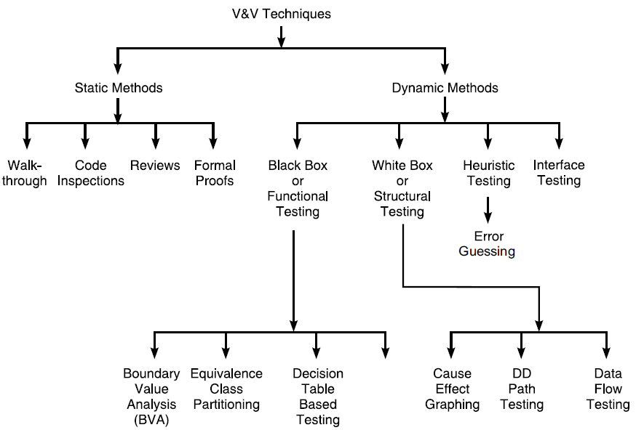
Software Testing
V&V Techniques
Together Verification and Validation forms the complete Testing

Slide 19
Software Testing
V&V
V&V is to be done on –
Requirements
Design
Implementation (Code)
Testing Infra (Test Cases, etc)
Maintenance (Change Request)
V&V Activities –
Traceability Analysis
Interface Analysis
Risk Analysis
Walkthrough
Inspection
Test Plan Generation
Test Execution
Goals – To Ensure
Correctness
Completeness
Accuracy
Consistency
Testability
Readability

Slide 20
Software Testing
V&V Planning
V&V Plan or simply Test Plan. IEEE83b documents the guidelines for the contents of system, software, build, and module test plans
Identification of Goals
Selection of V&V Techniques –
Requirement Phase - Technical Reviews, Prototyping, and Simulations
Specifications Phase - Technical reviews, requirements tracing, prototyping, and simulations
Design Phase - Technical reviews, Requirements tracing, Prototyping, Simulation, HLD Review, LLD Reviews.
Implementation Phase - Technical reviews, requirements tracing, testing, and proof of correctness.
Maintenance Phase – As in Design Phase, Regression Testing
Technical Reviews Include - Walk Throughs and Inspections.

Slide 21
Software Testing
V&V Planning
Organizational Roles and Responsibilities – Dev, Test, SQA, Contractors.
Integrating V&V Approaches
Problem/Bug Tracking/Management
Test Execution Tracking – Test Runs, Resources Used, Time Taken, Bugs Found, etc
Asses – Quality of Product, Processes, Techniques.

Slide 22
Software Technical Reviews
Review Methodologies include –
Walkthroughs
Inspections
Audit – Review process by external authority
S. No. | Informal reviews | Formal reviews
1 | It is a type of review that typically occurs spontaneously among peers | It is a planned meeting
2 | Reviewers have no responsibility | Reviewers are held accountable for their participation in the review
3 | No review reports are generated | Review reports containing action items are generated and acted upon

Slide 23
Software Technical Reviews
S. No. | Inspections | Walkthroughs
1 | It is a five-step process that is well formalized | It has fewer steps than inspections and is a less formal process
2 | It uses checklists for locating errors | It does not use a checklist
3 | It is used to analyze the quality of the Process. | It is used to improve the quality of the product
4 | This process takes a longer time | It is a shorter process
5 | It focuses on training of junior staff | It focuses on finding defects

Slide 24
Inspection
Inspection –
Planning — The moderator plans the inspection. The inspection team is given relevant materials, and after that, the team schedules the inspection meeting and works together.
Overview meeting - Brief summary of the project and its code.
Preparation — Each inspection team conducts inspection checklists.
Inspection meeting — Inspectors point out flaws section by Section.
Rework — Fixing of issues found.
Follow-up — Meeting with the team to discuss the reviewed and fixed code.

Slide 25
STANDARD FOR SOFTWARE TEST DOCUMENTATION (IEEE829)
Test Plan
Test-plan Identifier
Introduction - Features to be tested, Reference to other documents
Test Items
Features to be Tested
Approach
Item Pass/Fail Criteria
Suspension Criteria and Resumption
Test Deliverables
Testing Tasks
Environmental Needs
Responsibilities
Staffing and Training Needs
Schedule
Risks and Contingencies
Approvals: Specifies the persons who must approve this plan

Slide 26
STANDARD FOR SOFTWARE TEST DOCUMENTATION (IEEE829)
Test Case Specification
Test-case Specification Identifier
Test Items
Input Specifications
Output Specifications
Environmental Needs
Test-Incident Report (Bug Report)
Bug-Report Identifier
Summary
Bug Description
Impact: Priority, Severity (urgent, high, medium, low).
Test-Summary Report
Inspection Checklist for Test Plans
Inspection Checklist for Test Cases

Slide 27
Software Testing
White-Box Testing and Black-Box
Software Test Classification
White box (structural) testing. Examines internal calculation paths in order to identify bugs. Also called as structural testing or clear-box or Glass-Box or Open-box testing.
IEEE definition
Testing that takes into account the internal mechanism of a system or component
Black box (functionality) testing. Identifies bugs only according to software malfunctioning as they are revealed in its erroneous outputs. Does not care about internal path of calculations and processing performed.
IEEE definitions
(1) Testing that ignores the internal mechanism of a system or component and focuses solely on the outputs generated in response to selected inputs and execution conditions.
(2) Testing conducted to evaluate the compliance of a system or component with specified functional requirements.

Slide 28
Software Testing Strategies
Software Testing Strategies
Positive Testing – Test with legal Test Data to observe Normal behavior
Negative Testing – Test with illegal or abnormal data and observe the behavior.
Big Bang Testing (Entire System)
Unit testing
Integration Testing
System Testing
Top-Down ; Bottom-Up
Stubs Testing (Unavailable Lower Level Module) (Top Down Methodology)
Driver Testing (Unavailable Upper Level Module) (Bottom Up Methodology)
Static Testing
Code Reviews, Code Inspections, Walkthroughs, and software technical reviews (STRs)

Slide 29
Unit, Integration, System Testing
Unit Testing
Individual module is tested in isolation from the Rest of the Software.
Integration Testing
One or more modules are tested together
Interactions between the modules is tested
Top-Down, Bottom-Up, Sandwich (Bi-Directional Integration), Big-Bang.
System Testing
Testing on complete integrated product including H/W and S/W
Includes functional and Non-functional tests.

